Slide 1
Peer to Peer Books Management System
Advanced Software Paradigms CSCI-6221
VPN Host:209.40.196.115

Slide 2
Project Architechture
Project hosting
- VPS hosting
Project running enviroment
- Unix-based operating system
- MySQL database server
- APACHE web server
- Drupal 7 as top level platform
- LIBREEP PHP based application
Project development tools:
- Netbeans IDE
- GIT revision control and source code management system
- MySQL Workbench and other
Entity Relation Mode

Slide 3
Project Architechture Continued
Linux Operating Environment
Platform (Drupal)
Team Members
LIBREEP
Collabaration Tools
Web Server (apache)
Database Server
(MySQL)

Slide 4
User Interfaces Map
forget password
login
new user password
view history of orders from library
STUDENT HOMEPAGE
LIBRARIAN HOMEPAGE
edit personal profile
view personal profile
view personal profile
edit personal profile
initiate an order from the library
add new book
Search for books
view list of books (search and filter)
delete book
initiate an order from a student
Peer Orders
edit book
Incoming Orders
Outcoming Orders
view list of students (search and filter)
view student profile
accept/reject requests
view list of books to give
view list of books to receive
view completed requests
view rejected requests
view approved requests
view list of books to take
view list of books to return
view rejected requests
view completed requests
view list of orders (search and filter)
edit existing order

Slide 5
Entity Relationship Model
app_users
app_university
is a
app_peer_borrowing_ options_dic
app_peer_order_status
app_peer_order
app_librarians
app_students
app_peer_order_ status_history
app_book
app_book-info
app_users_review
app_order
app_orders_status

Slide 6
Paradigm: Peer Book Sharing
STEP 1
Student 1
Student 1I
Borrows the book from the library
From April 15th to April 25th
Urgently needs the same book,
and this book is not available from the library
Library

Slide 7
Paradigm: Peer Book Sharing
STEP 2
Searches the book and finds out that the Student I is willing to share this book
Student 1I
Student 1
Requests the book to be peer shared From April 18th to April 20th

Slide 8
Paradigm: Peer Book Sharing
STEP 3
Student 1
Reviews the request
Accepts the request
Rejects the request
email sent to Student I
email sent to Student II

Slide 9
Paradigm: Peer Book Sharing
STEP 4
System
Generates the unique transaction number for the requester:
Nkq10c
Generates a MD5 of the number for the owner:
25e5cf9e845502dc2819b2225e28c698
Student 1
Student 1I

Slide 10
Paradigm: Peer Book Sharing
STEP 5 - Meeting 1: giving the book
Student 1I
Nkq10c
Validation
Enter (Nkq10c) to the system
Student 1
Gives the Book
OR
MD5(Nkq10c)

Slide 11
Paradigm: Peer Book Sharing
STEP 6
System
Generates the unique transaction for the requester:
K817P3
Generates a hash of the number for the owner:
21b6e231c3c4088378d23fe319a7a5c9
Student 1
Student 1I

Slide 12
Paradigm: Peer Book Sharing
STEP 7 - Meeting 2: returning the book
Student I
K817P3
Validation
Enter (K817P3) to the system
Student II
Returns the Book
OR
MD5(K817P3)

Slide 13
Paradigm: Peer Book Sharing
STEP 8 - Transaction Complete
Evaluates
Student I
Student II
Evaluates

Slide 14
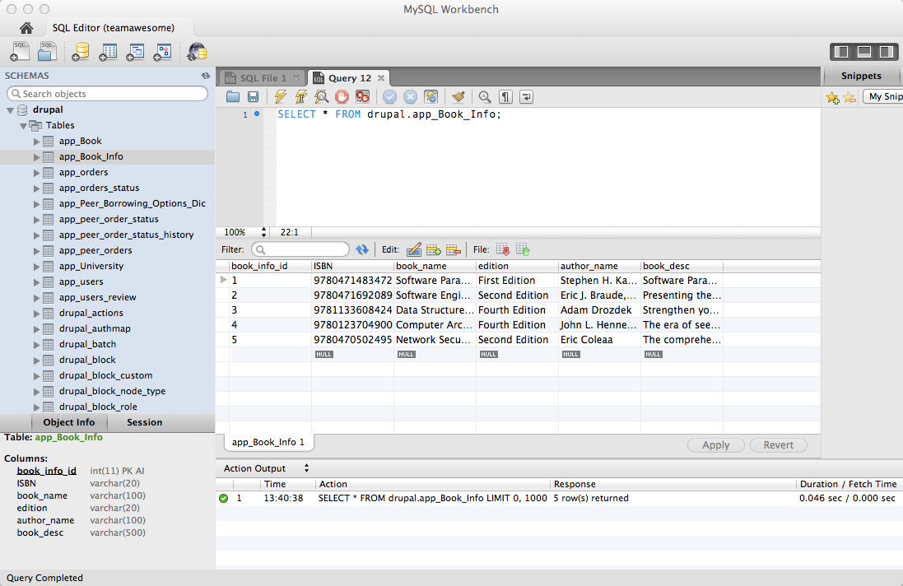

Database view

Slide 15
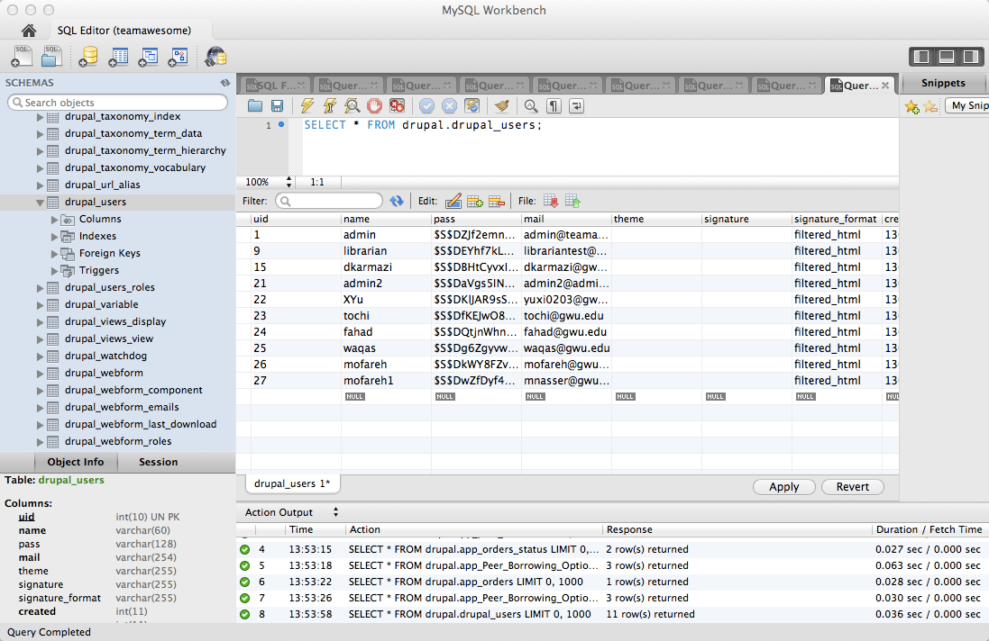

Slide 16
